Slide 1
UNIT I : Introduction to Big Data
SESSION : 01
TOPIC : Introduction to Big Data
Industry/Tech: Analog Devices, Database Registers
Problem statement:
What is Big Data?
Big Data is a collection of large datasets that cannot be processed using traditional computing techniques. For example, the volume of data Facebook or Youtube need require it to collect and manage on a daily basis, can fall under the category of Big Data. However, Big Data is not only about scale and volume, it also involves one or more of the following aspects − Velocity, Variety, Volume, and Complexity.

Slide 2
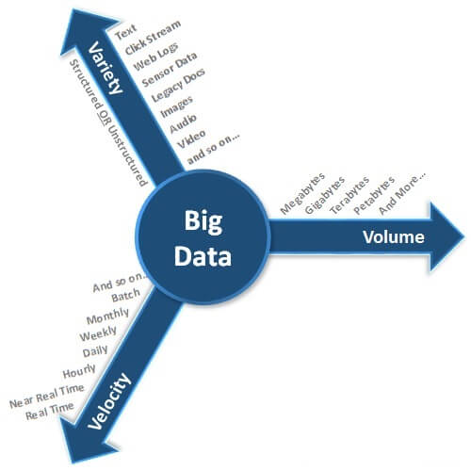
UNIT I : Introduction to Big Data
SESSION : 01
TOPIC : Introduction to Big Data
Industry/Tech: Analog Devices, Database Registers

Slide 3
UNIT I : Introduction to Big Data
SESSION : 01
TOPIC : Introduction to Big Data
Industry/Tech: Analog Devices, Database Registers

Slide 4
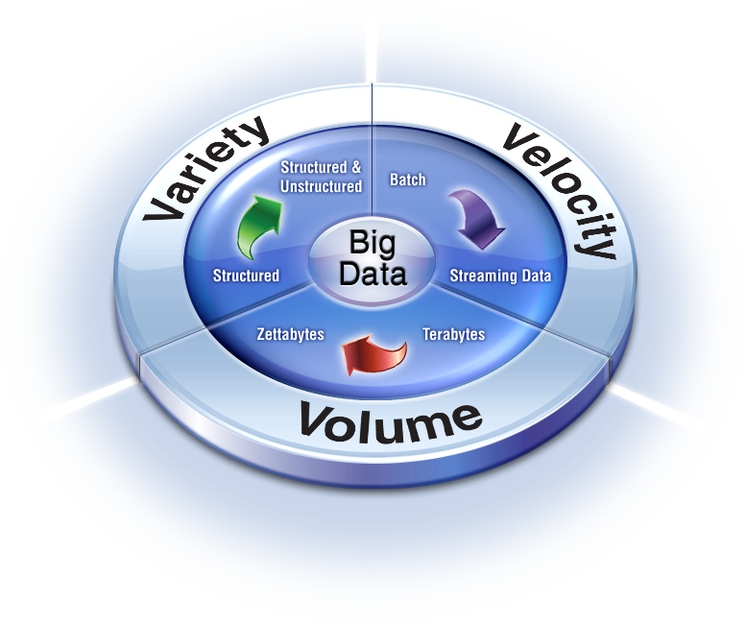
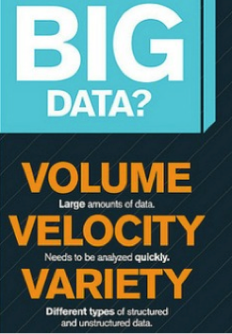
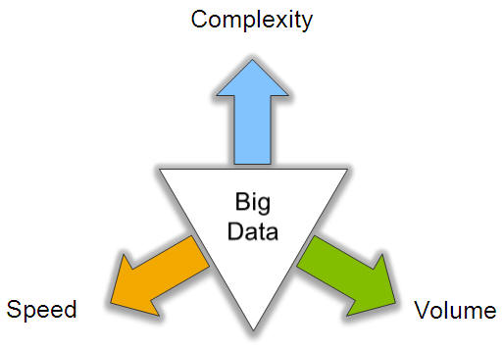
UNIT I : Introduction to Big Data
SESSION : 01
TOPIC : Introduction to Big Data
Industry/Tech: Analog Devices, Database Registers
Characteristics of Big data: V3

Slide 5
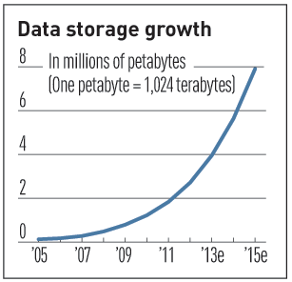
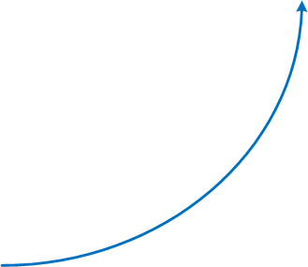
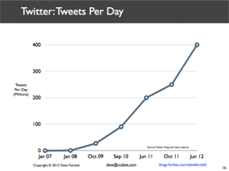
UNIT I : Introduction to Big Data
SESSION : 01
TOPIC : Introduction to Big Data
Industry/Tech: Analog Devices, Database Registers
V3 : V for Volume
Volume of data, which needs to be processed is increasing rapidly
More storage capacity
More computation
More tools and techniques

Slide 6
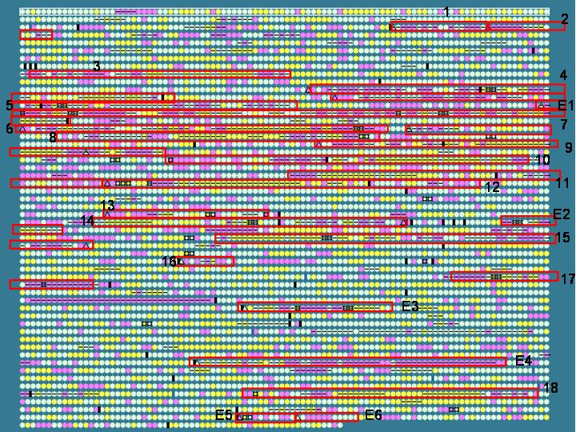
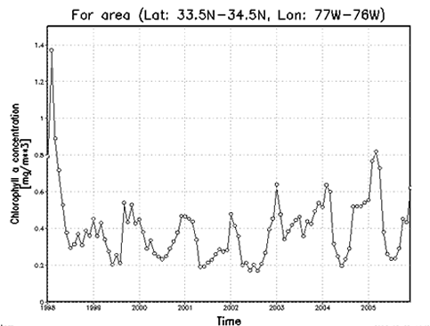
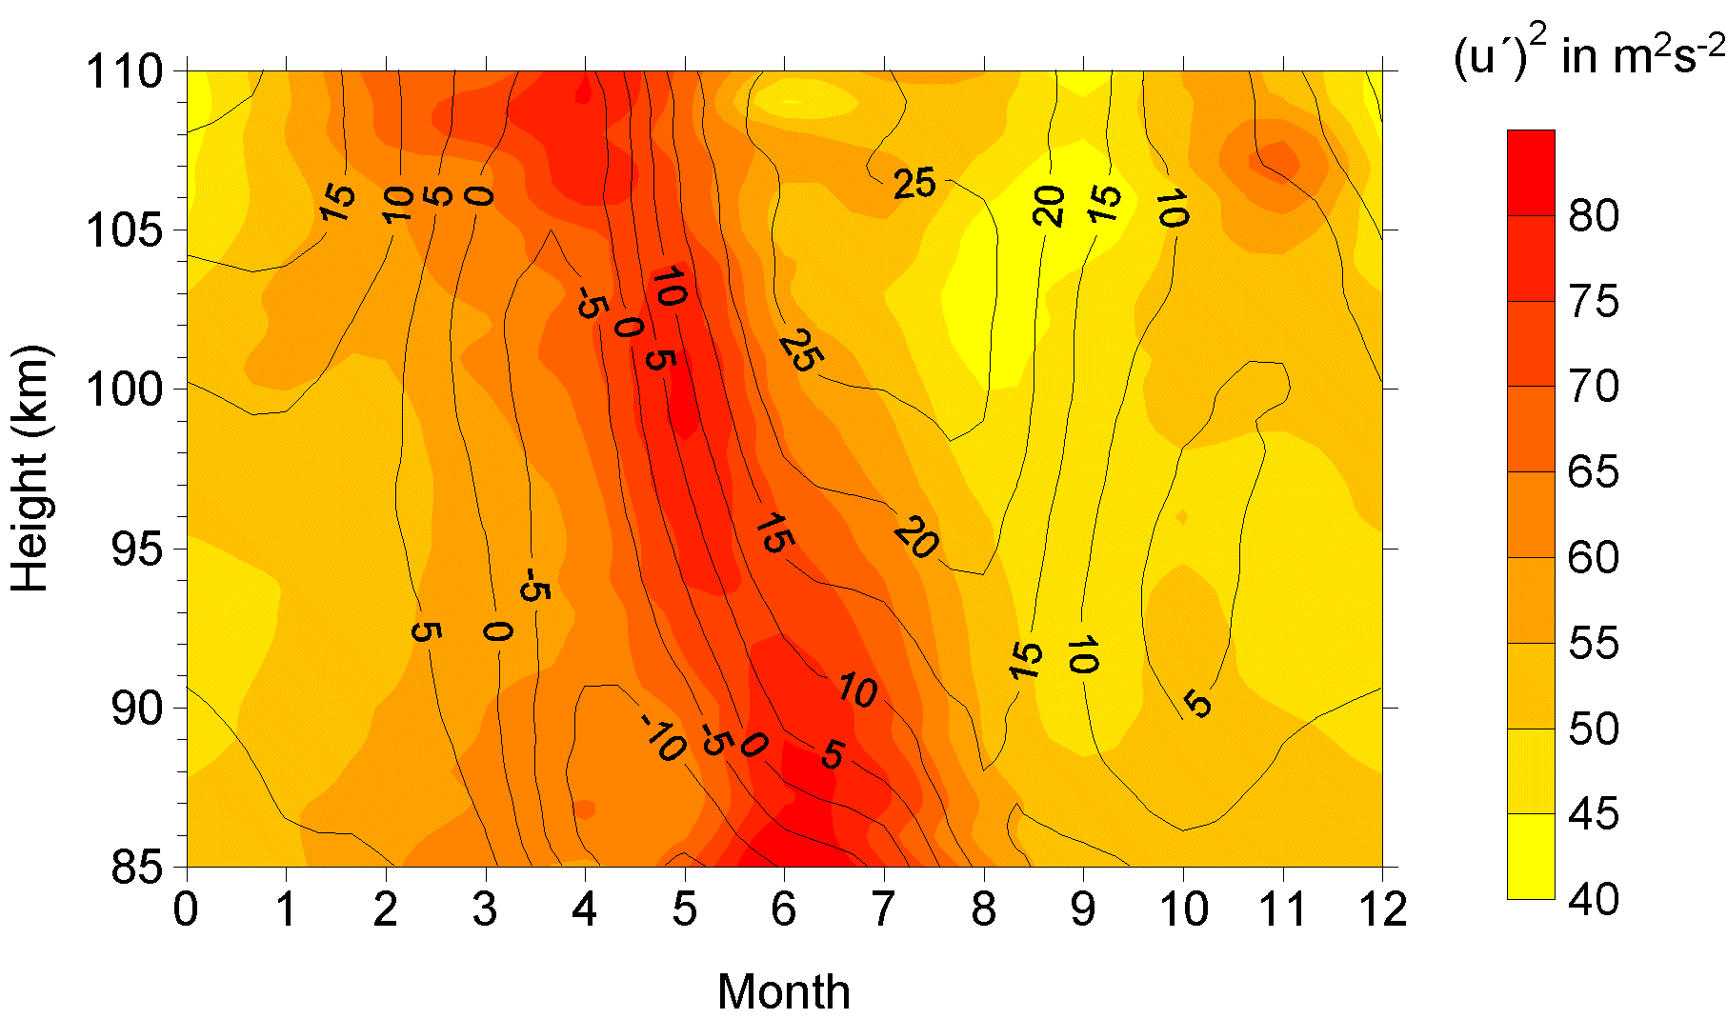
UNIT I : Introduction to Big Data
SESSION : 01
TOPIC : Introduction to Big Data
Industry/Tech: Analog Devices, Database Registers
V3: V for Variety
Various formats, types, and structures
Text, numerical, images, audio, video, sequences, time series, social media data, multi-dimensional arrays, etc…
Static data vs. streaming data
A single application can be generating/collecting many types of data
To extract knowledge➔ all these types of data need to be linked together

Slide 7
UNIT I : Introduction to Big Data
SESSION : 01
TOPIC : Introduction to Big Data
Industry/Tech: Analog Devices, Database Registers
Data is being generated fast and need to be processed fast
For time-sensitive processes such as catching fraud, big data must be used as it streams into your enterprise in order to maximize its value
Scrutinize 5 million trade events created each day to identify potential fraud
Analyze 500 million daily call detail records in real-time to predict customer churn faster
Sometimes, 2 minutes is too late!
The latest we have heard is 10 ns (nano seconds) delay is too much
V3: V for Velocity

Slide 8
UNIT I : Introduction to Big Data
SESSION : 01
TOPIC : Introduction to Big Data
Industry/Tech: Analog Devices, Database Registers
Characteristics of Big Data.
3 ‘V’s of Big Data – Variety, Velocity, Volume.
Variety
Variety of Big Data refers to structured, unstructured, and semi structured data that is gathered from multiple sources. While in the past, data could only be collected from spreadsheets and databases, today data comes in an array of forms such as emails, PDFs, photos, videos, audios, SM posts, and so much more.
Velocity
Velocity essentially refers to the speed at which data is being created in real-time. In a broader prospect, it comprises the rate of change, linking of incoming data sets at varying speeds, and activity bursts.

Slide 9
UNIT I : Introduction to Big Data
SESSION : 01
TOPIC : Introduction to Big Data
Industry/Tech: Analog Devices, Database Registers
Volume
We already know that Big Data indicates huge ‘volumes’ of data that is being generated on a daily basis from various sources like social media platforms, business processes, machines, networks, human interactions, etc. Such a large amount of data are stored in data warehouses.
Types of Big Data
Structured
By structured data, we mean data that can be processed, stored, and retrieved in a fixed format. It refers to highly organized information that can be readily and seamlessly stored and accessed from a database by simple search engine algorithms. For instance, the employee table in a company database will be structured as the employee details, their job positions, their salaries, etc., will be present in an organized manner.

Slide 10
UNIT I : Introduction to Big Data
SESSION : 01
TOPIC : Introduction to Big Data
Industry/Tech: Analog Devices, Database Registers
Unstructured
Unstructured data refers to the data that lacks any specific form or structure whatsoever. This makes it very difficult and time-consuming to process and analyze unstructured data. Email is an example of unstructured data.
Semi-structured
Semi-structured data pertains to the data containing both the formats mentioned above, that is, structured and unstructured data. To be precise, it refers to the data that although has not been classified under a particular repository (database), yet contains vital information or tags that segregate individual elements within the data.

Slide 11
UNIT I : Introduction to Big Data
SESSION : 01
TOPIC : Introduction to Big Data
Industry/Tech: Analog Devices, Database Registers
Sources of big data

Slide 12
UNIT I : Introduction to Big Data
SESSION : 01
TOPIC : Introduction to Big Data
Industry/Tech: Analog Devices, Database Registers
Objective:
The basic knowledge of Big data.
Outcome:
Students are learnt about the basic idea of Big Data, Characteristics of Big Data and Types of big Data.

